Slide 1

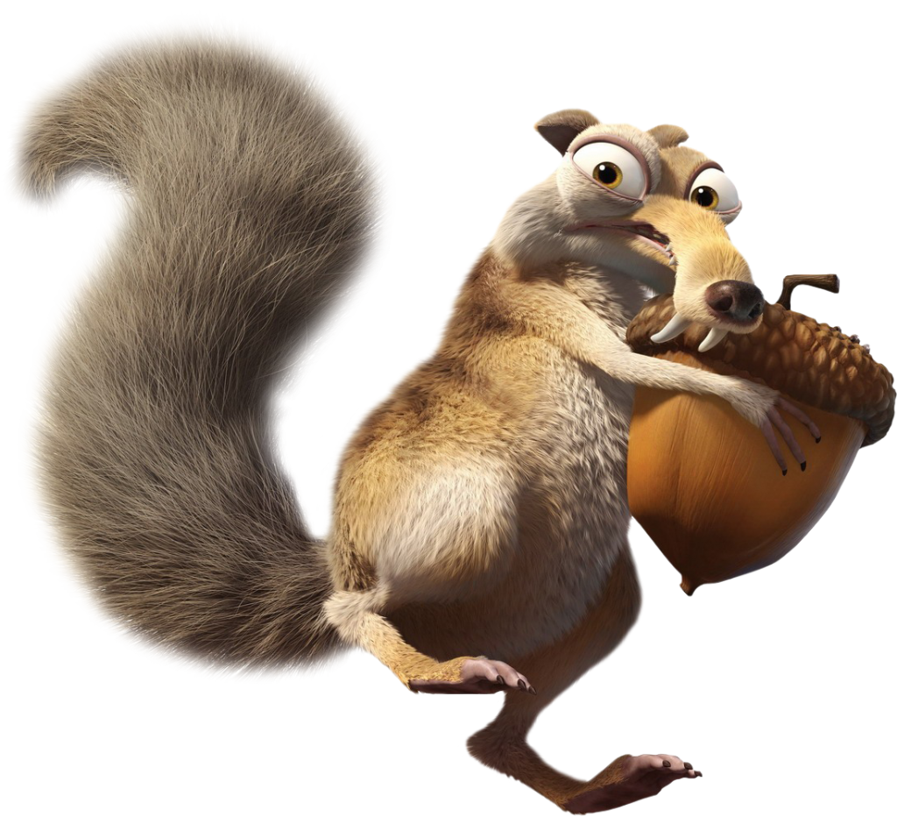
Ice Guard Surveillance System
…a success story

Slide 2
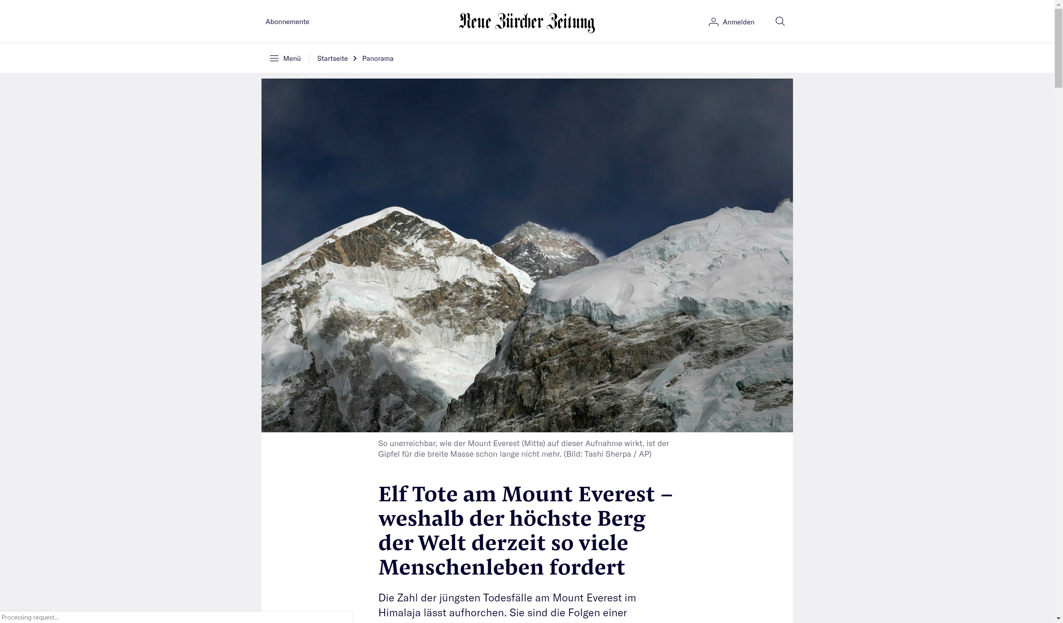
English translation: 11 deaths at mount everest

Slide 3
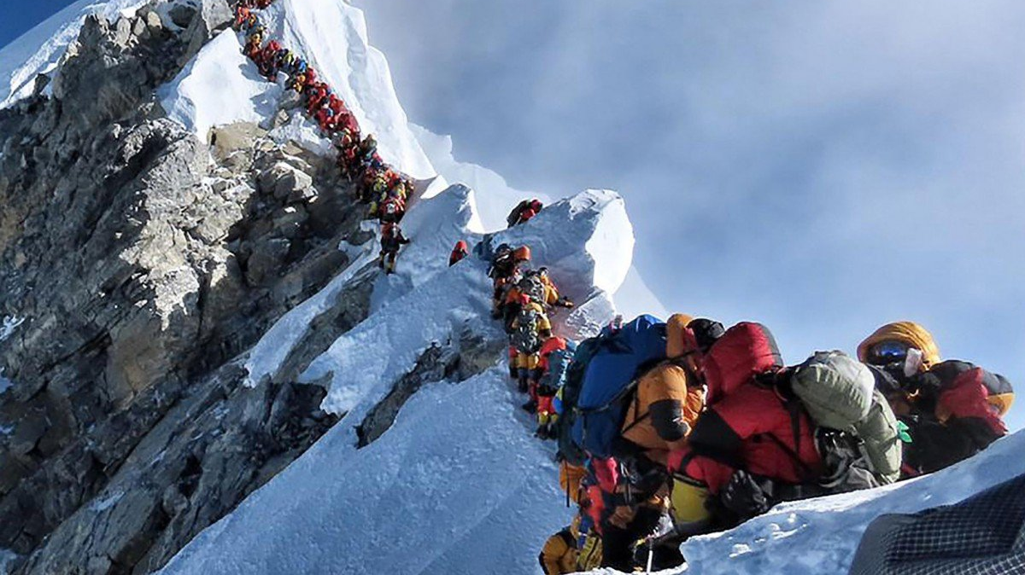
Market Analysis
11 deaths -> High demand for device to protect against ice!
WLAN connectivity might be unstable
First location for a shop: Mount Everest

Slide 4
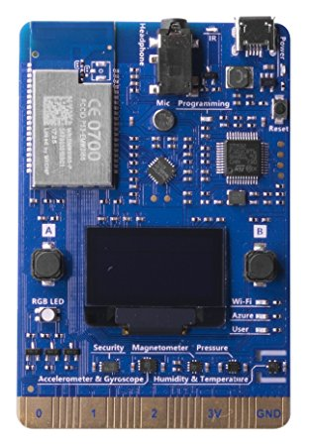
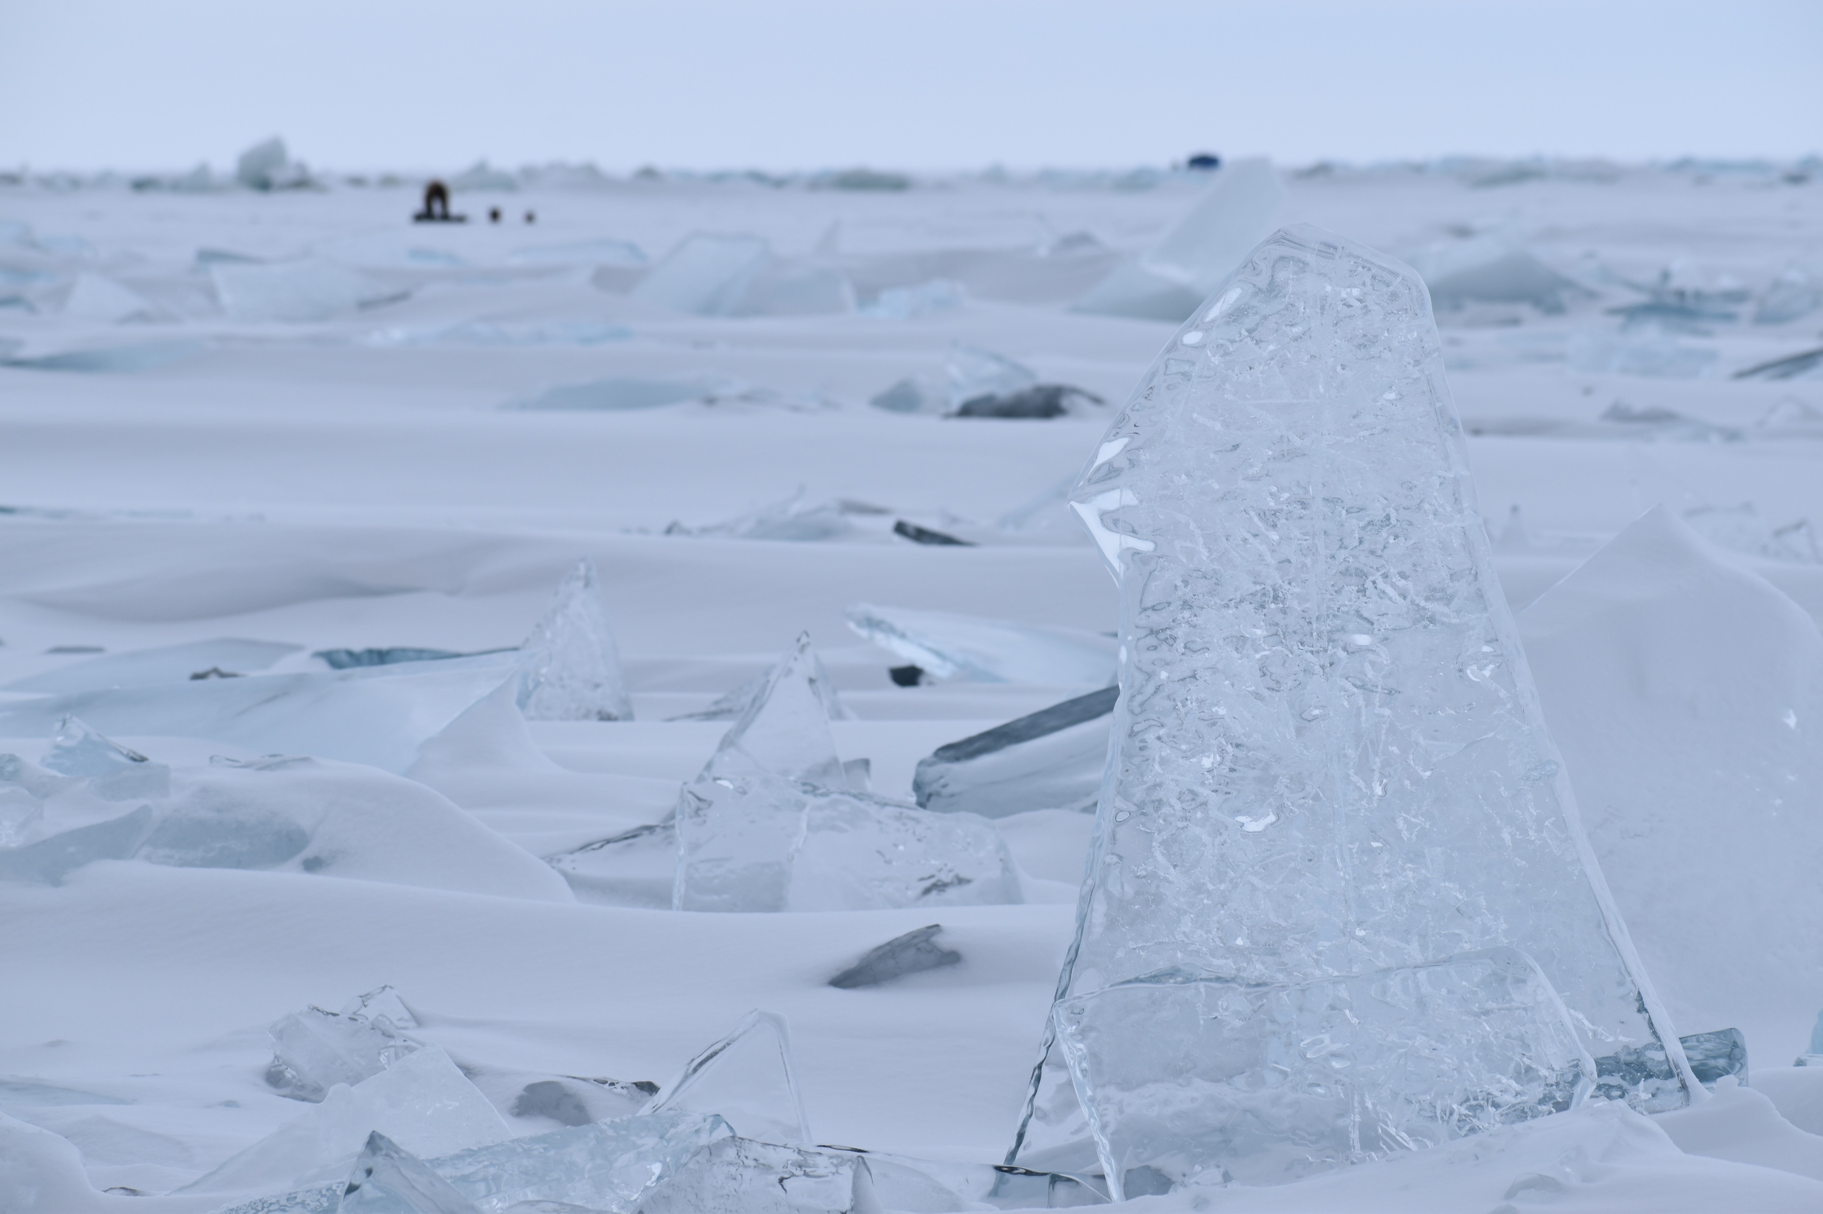
The Solution: Ice Guard Survival Chip
Measures your body temperature
How humid you are!
Counts your steps
Tells your supervisior if you are alive (green, good) or dead (red, not good)

Slide 5


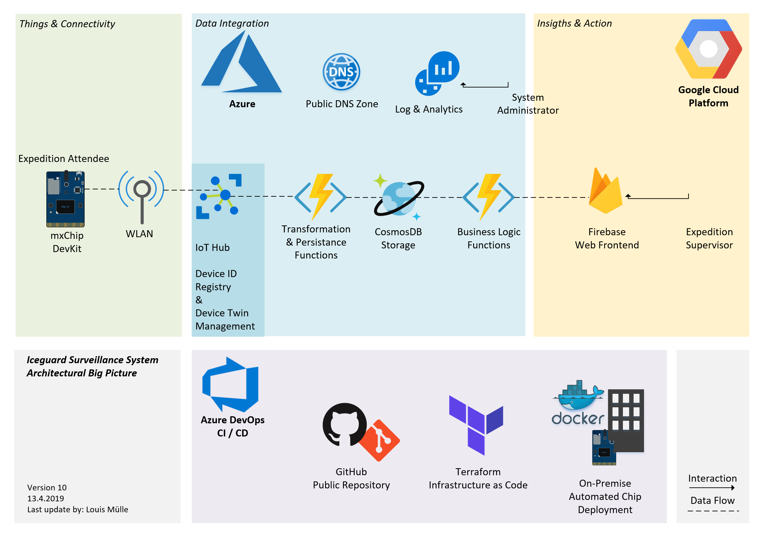


Internet of Things and Cloud Native stuff!
Real hardware, much wow!
2 Clouds! Such fancy!
Our DevOps Engineer

Slide 6
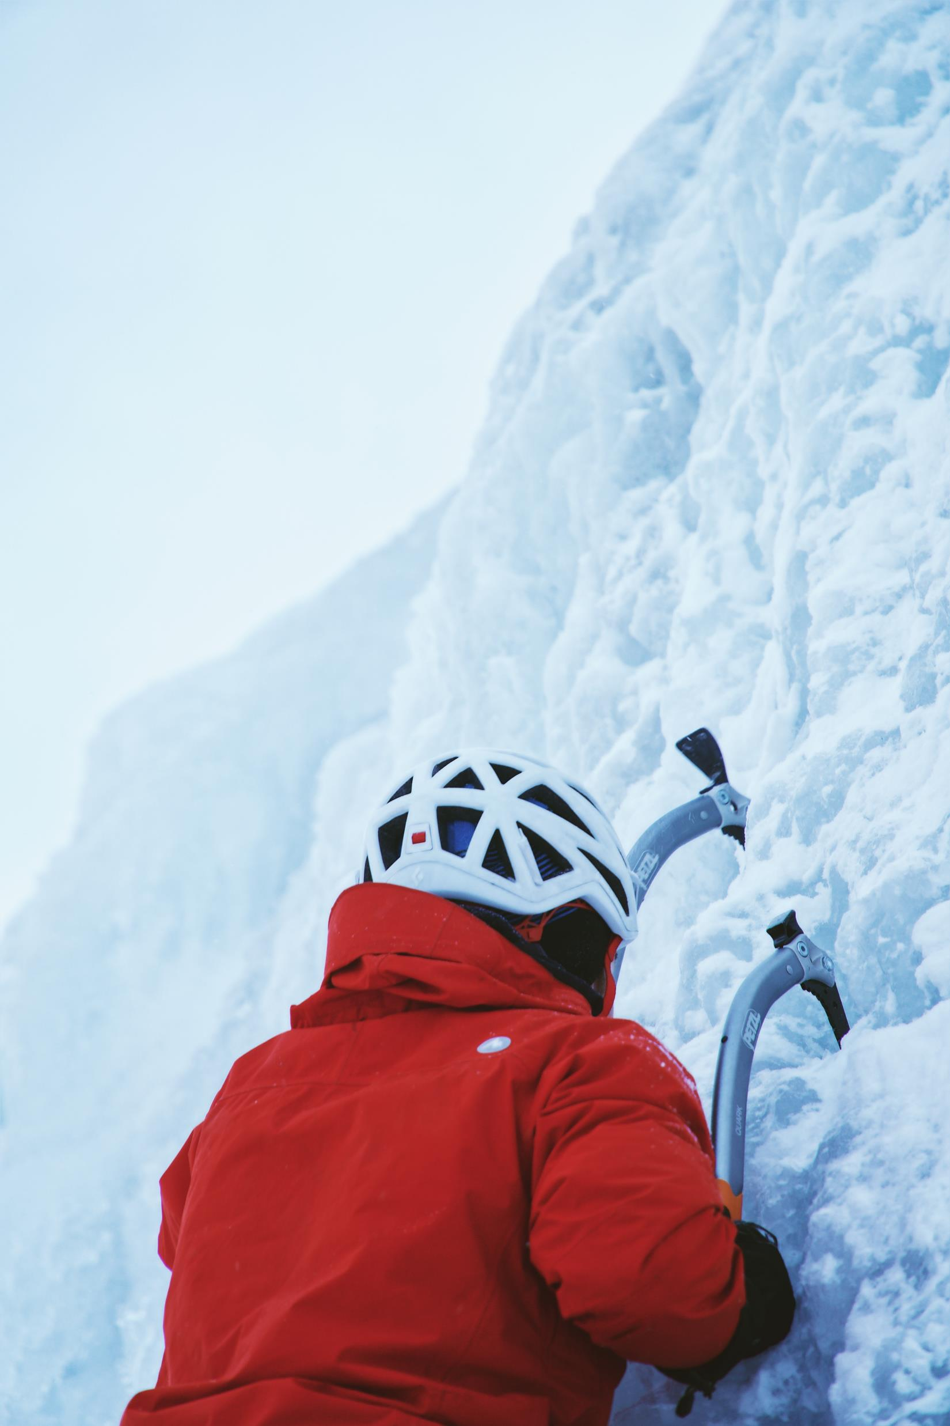
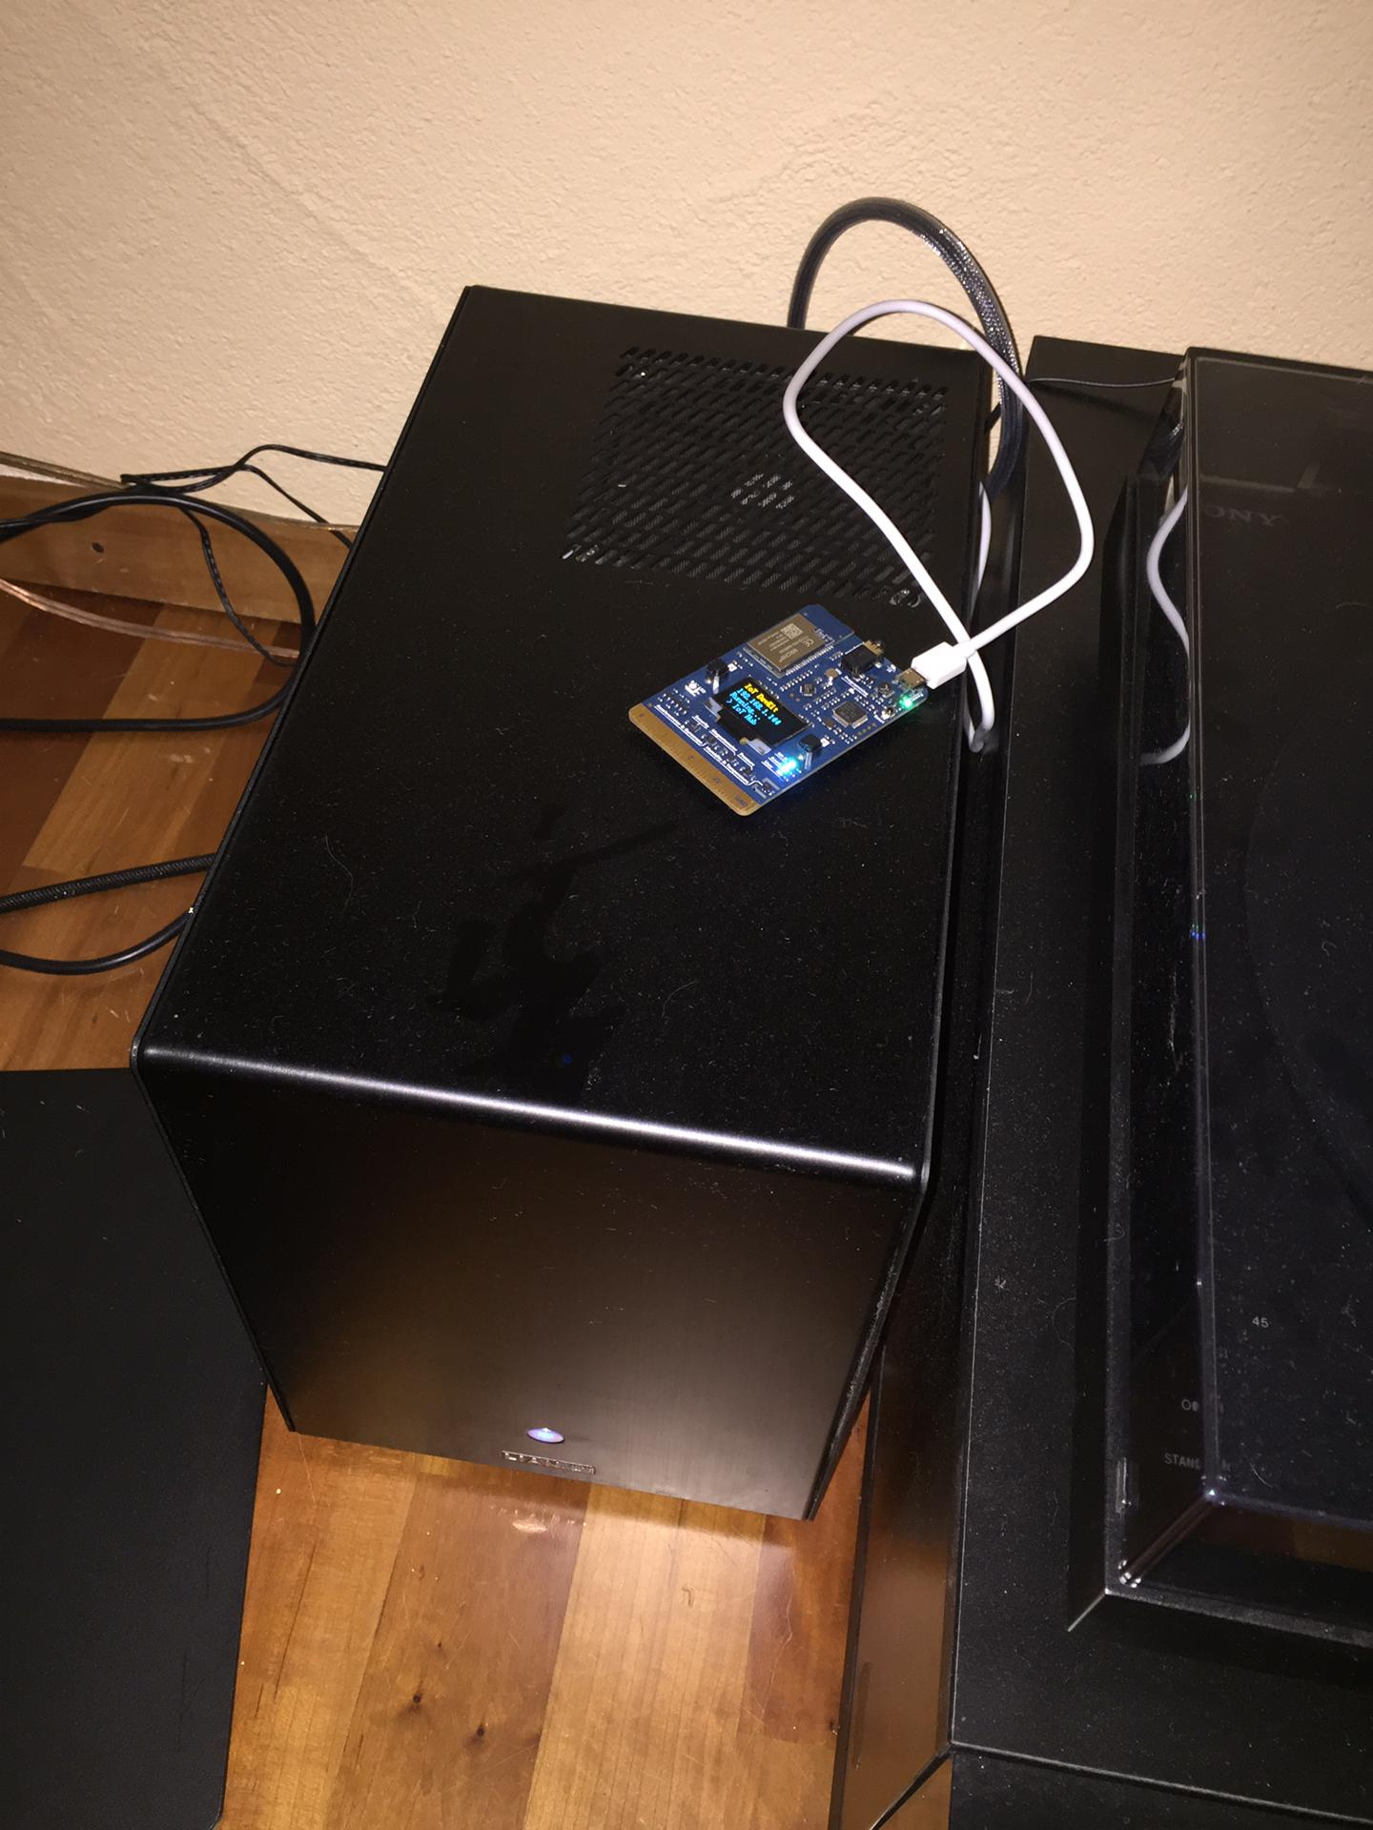
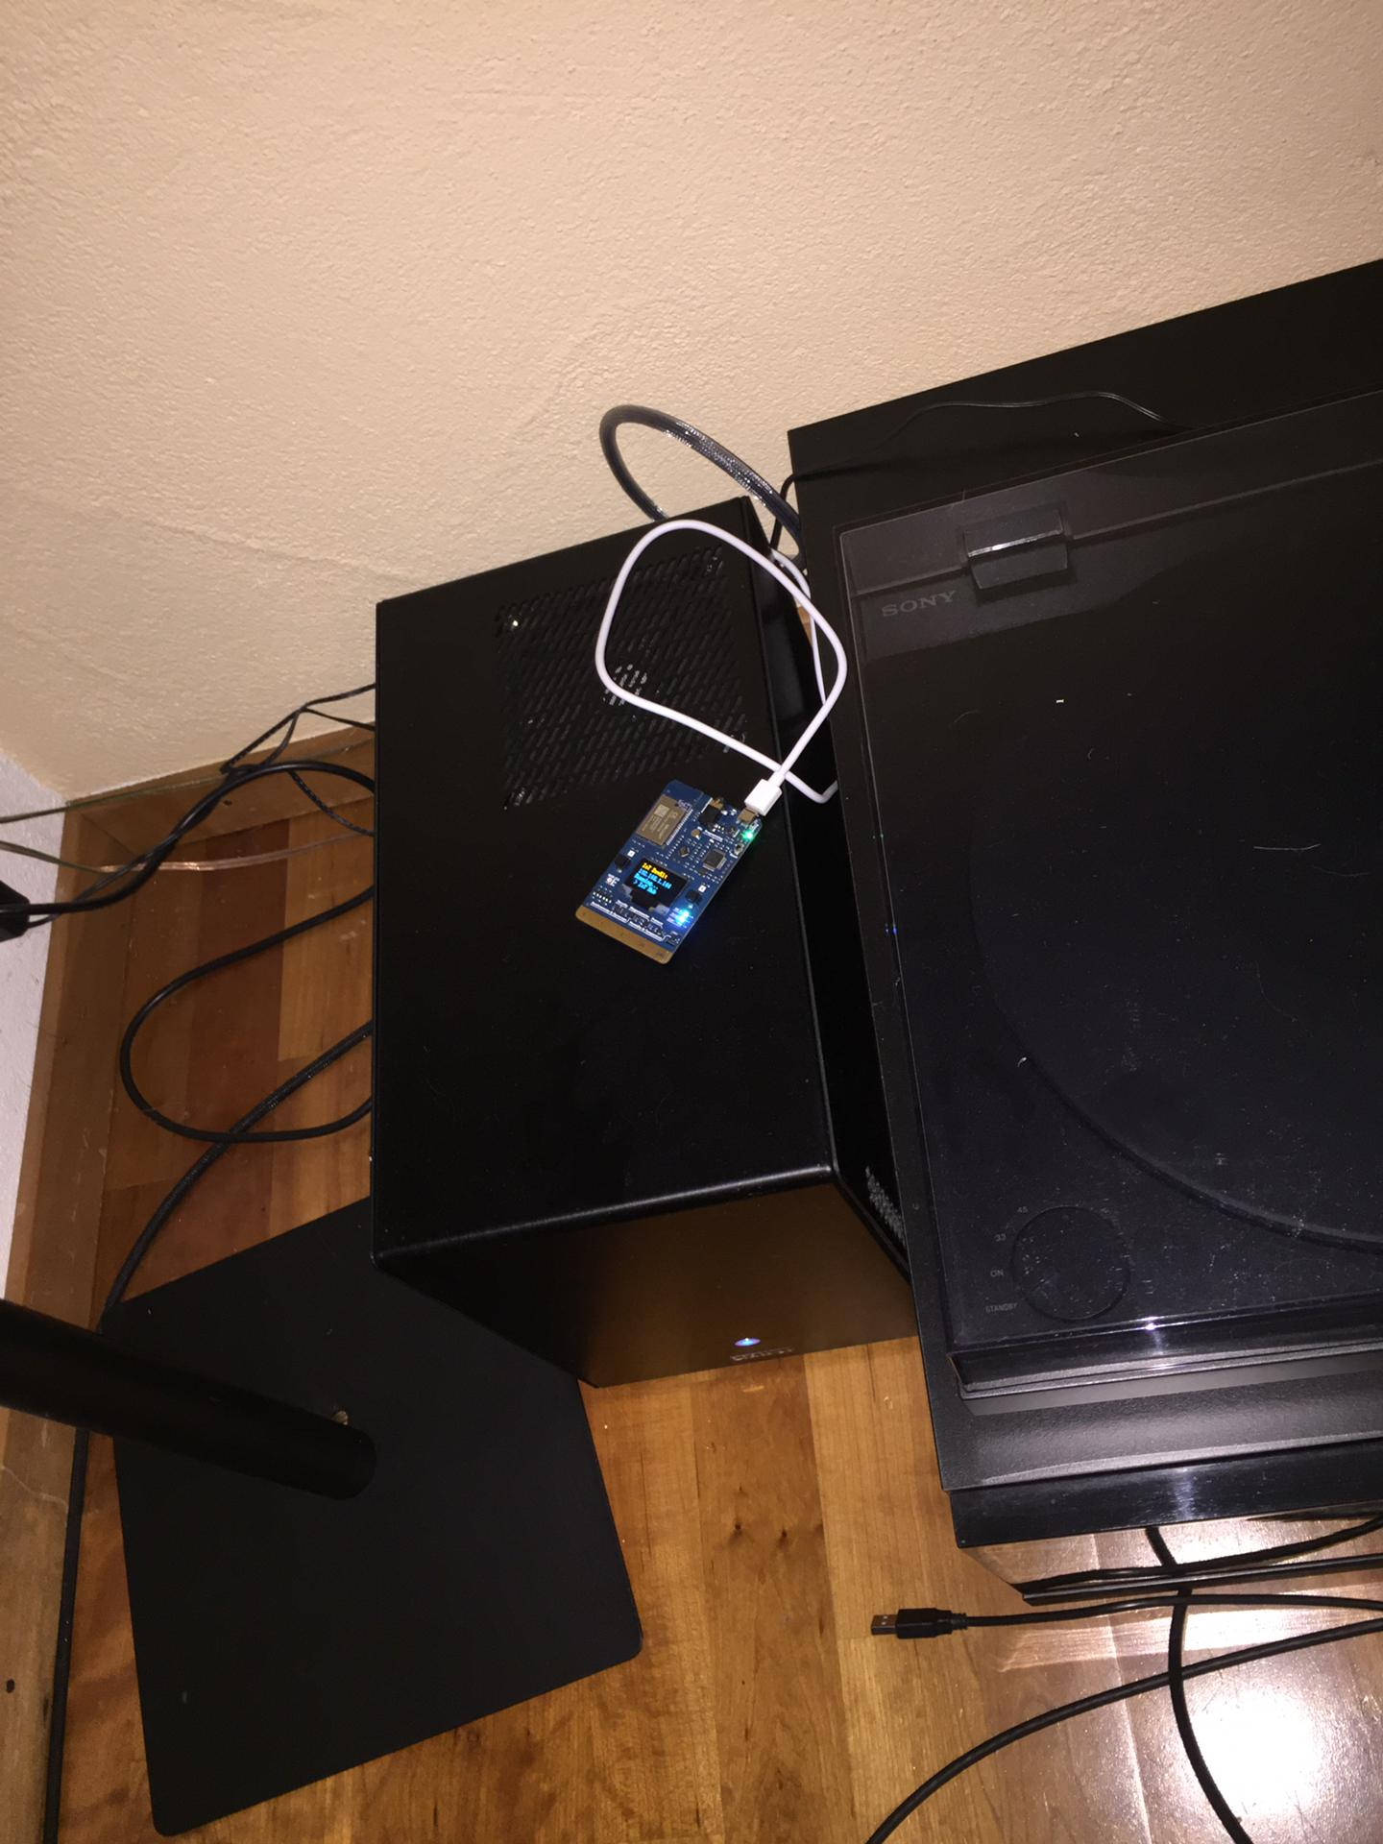
Demo
Testing & Fancy deployment

Slide 7
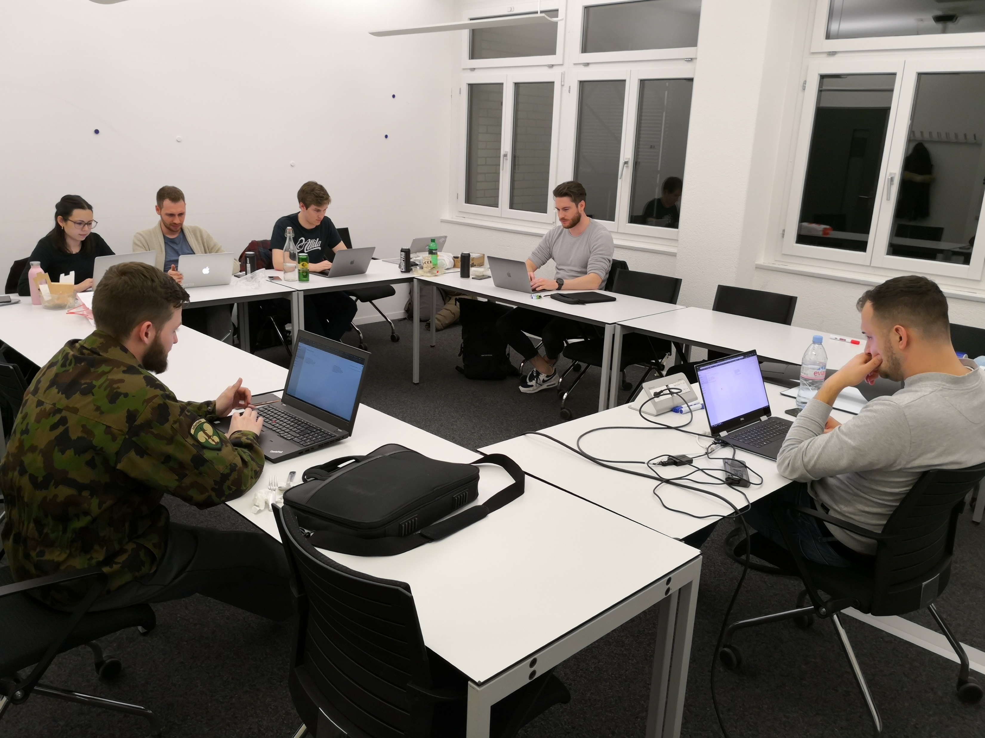
Arik:
Working on FaaS
Alicia:
Working on DB
Ramon:
Building a Pipeline
Kaspar:
on the toilet
Jonas:
Frontend Pro
The Team
Senad:
Scruming around
Simon:
Protector of the realm
Louis:
taking pictures
with a bad timing

Slide 8
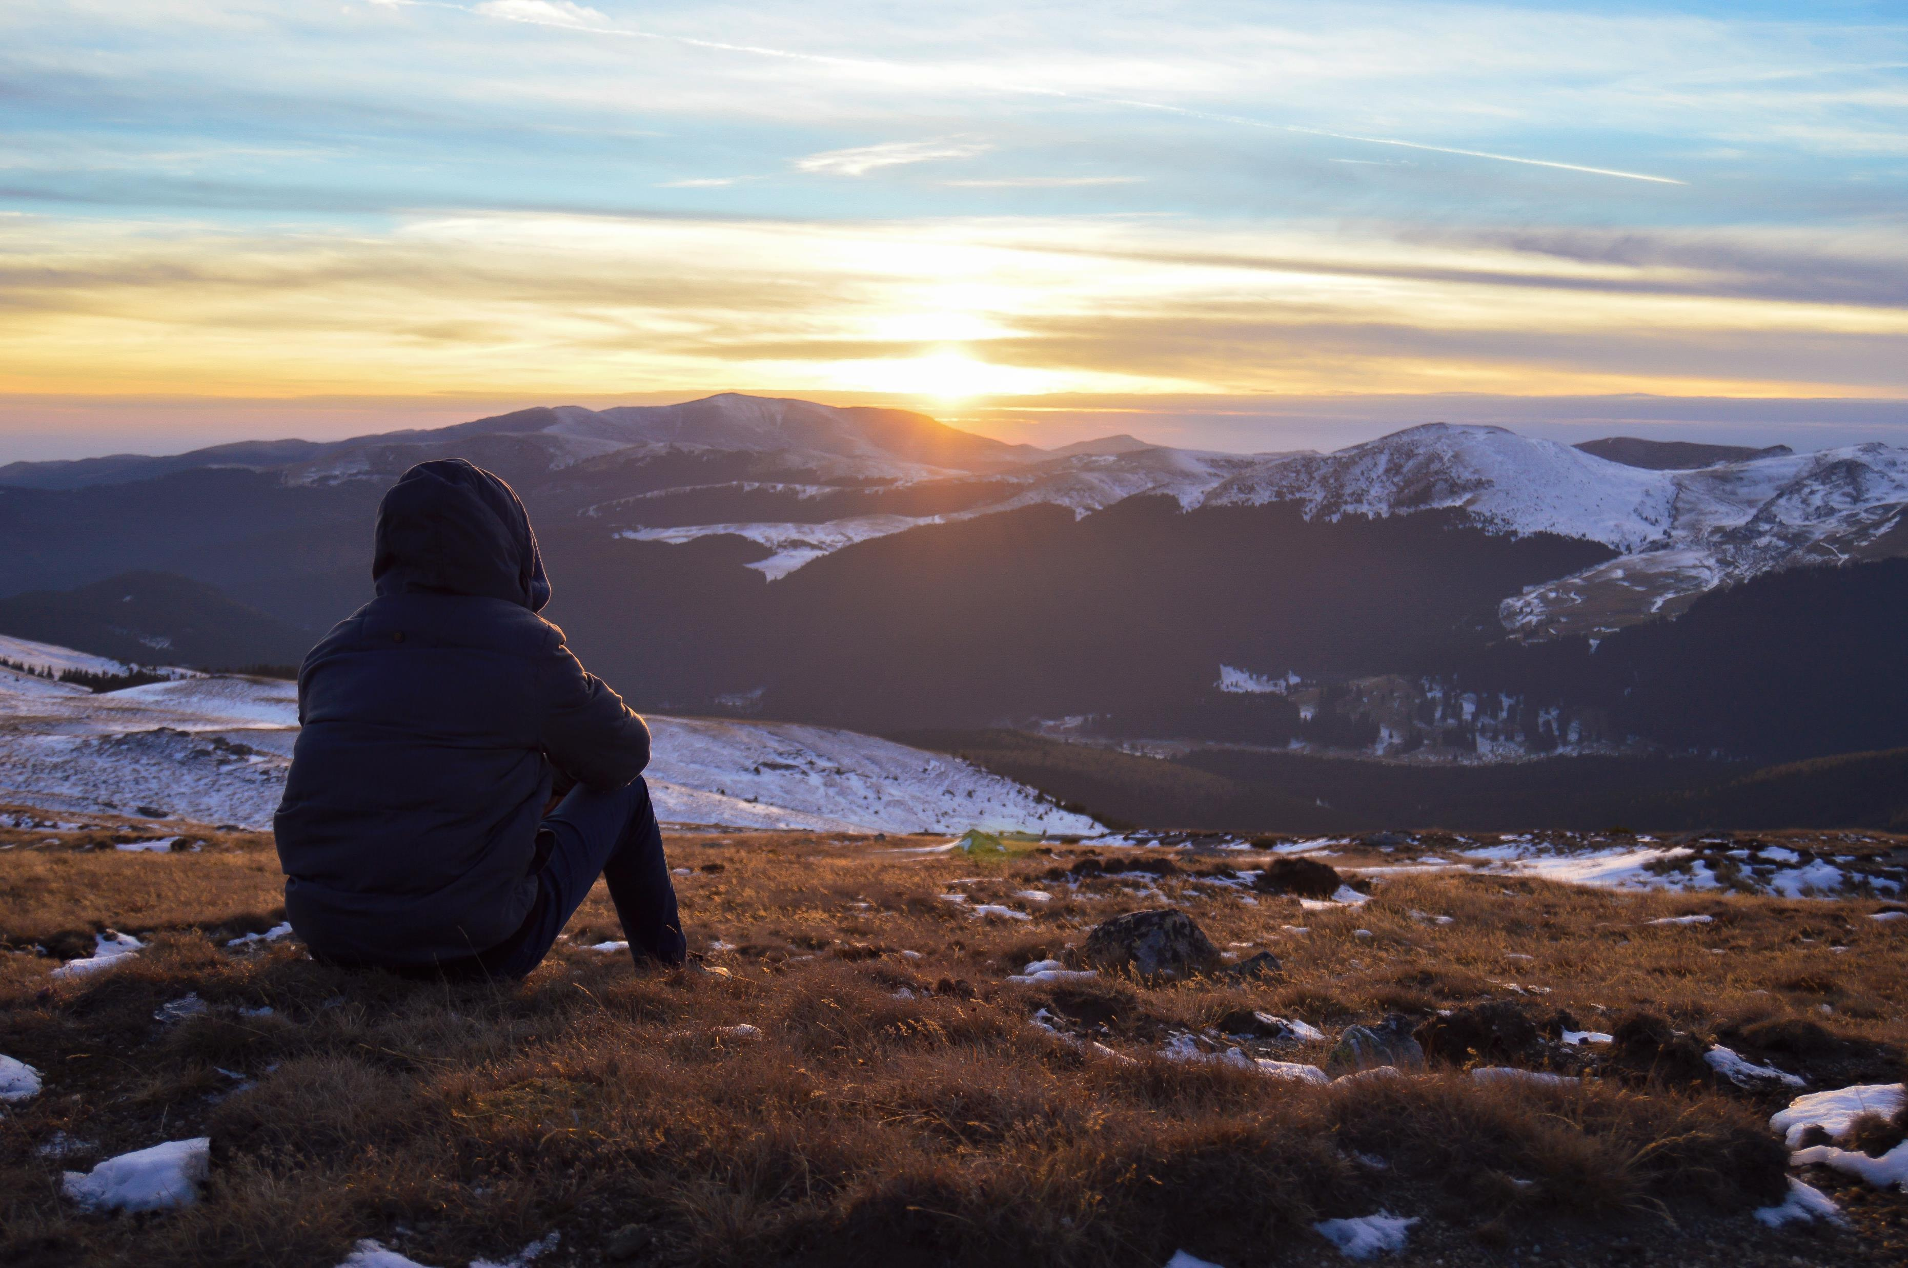
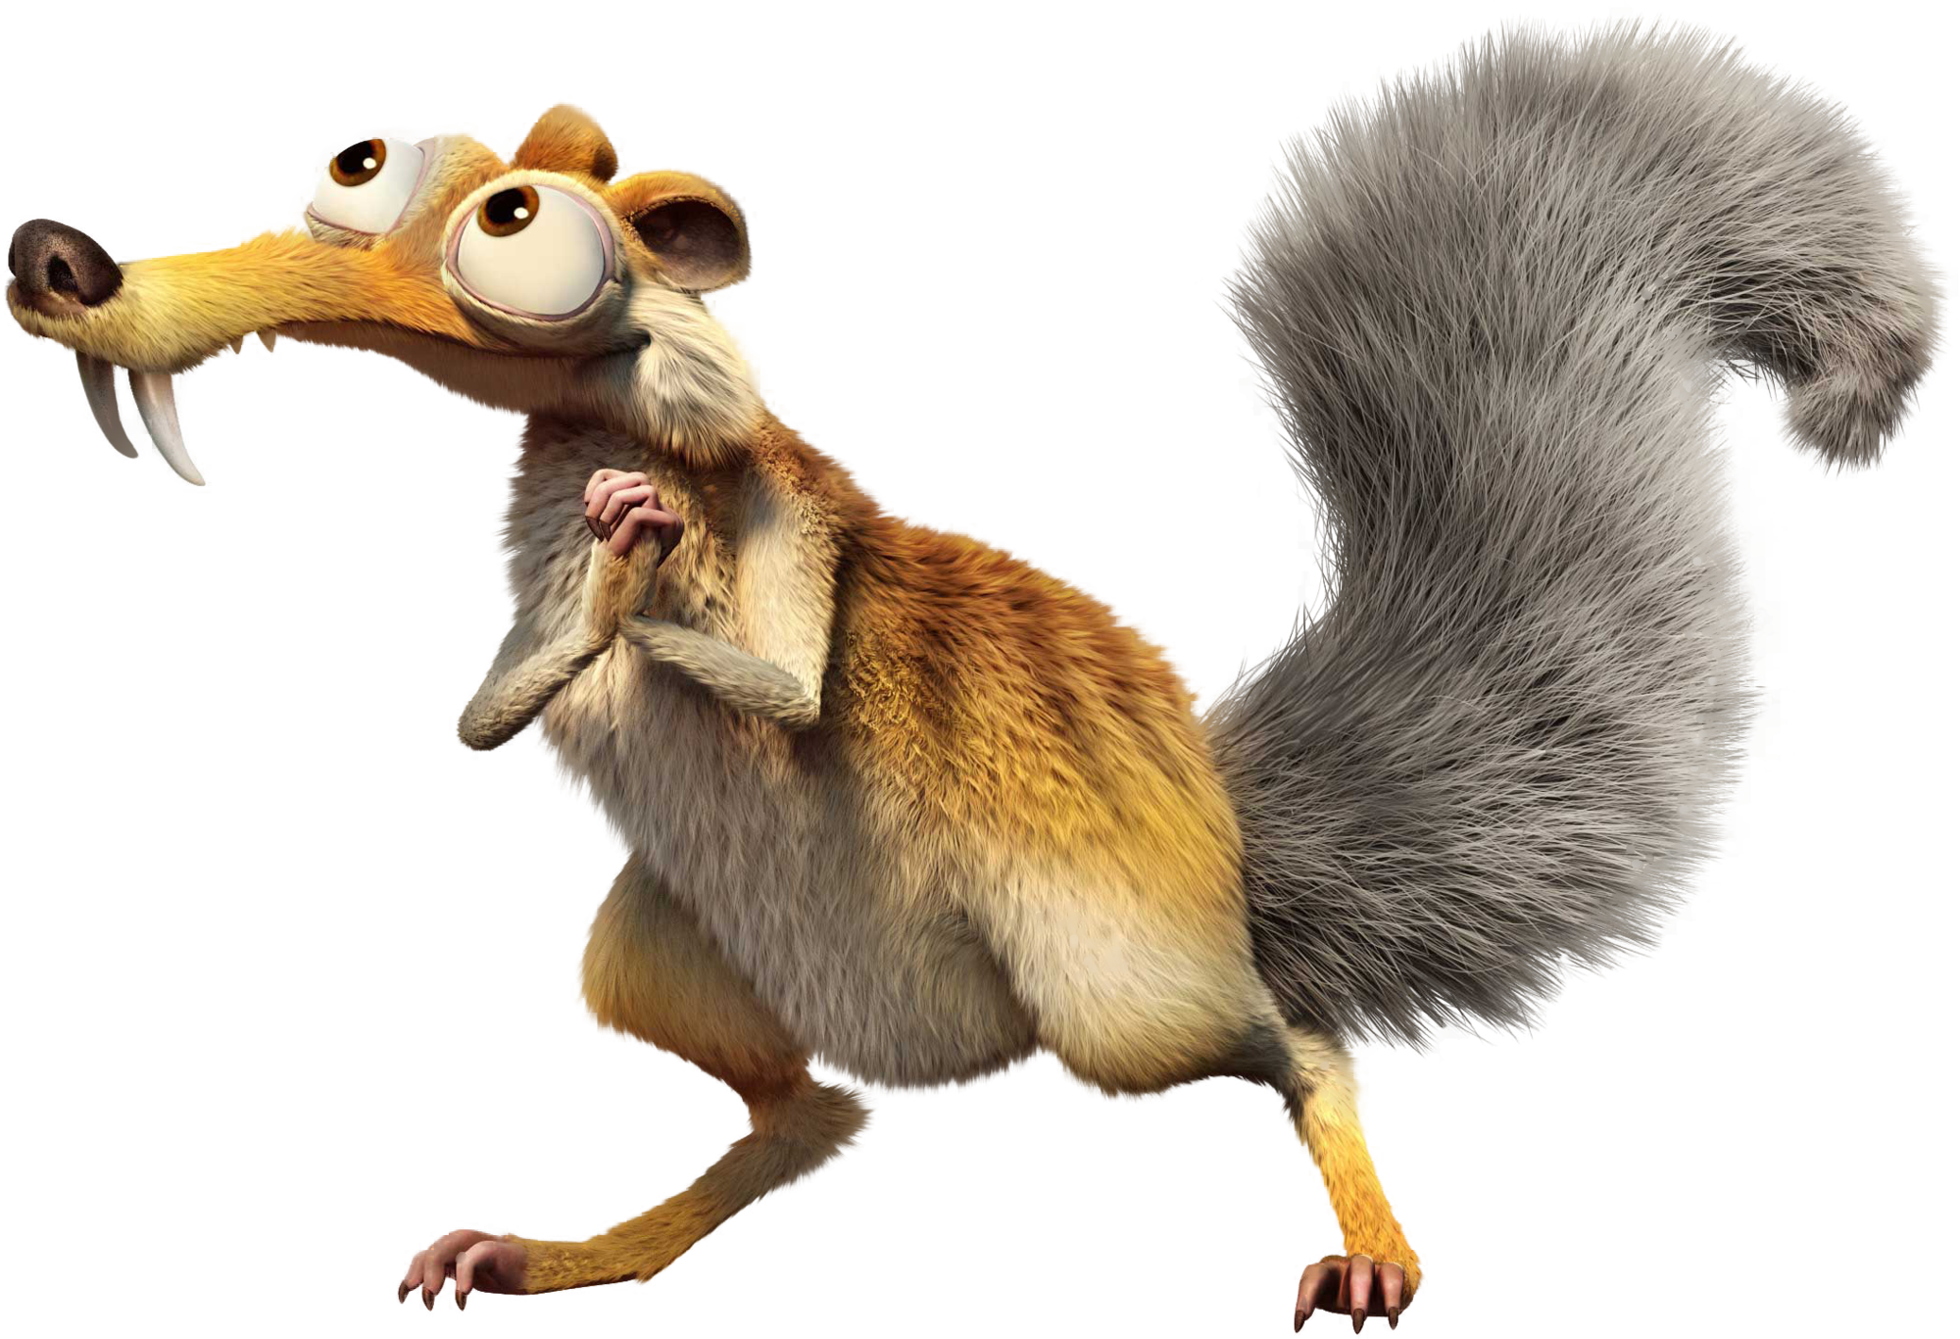
Learnings
Success through team diversity
Multi-cloud and multi-language for rapid MVP development and low future lock-in
Serverless and PaaS opens new possibilities
Hardware development is hard!

Slide 9

Questions?
This presentation was brought to you by:
IGSS

